Slide 1

Insider Trading
By: Oliver Diaz, Jeevan Hall,
Markus Just, Karen Marcos

Slide 2
INTRODUCTION
What is insider trading?
Why is it significant?
What story does our data tell?
How can we use our data to forecast/ prevent insider trading in the future?

Slide 3
DATASET
Insider Trading Dataset
Name:
URL:
Total Size:
Total Files Used Size:
File Format:
https://www.kaggle.com/datasets/layline/insidertrading?select=lit_nonderiv.csv
32. 47 GB
14.16 GB
CSV (Comma Separated Value)

Slide 4
TECHNICAL SPECIFICATIONS
Cluster Version:
Cluster Number of Nodes:
Memory Size:
HDFS Capacity:
Storage:
Hadoop 3.1.2
5 Nodes (2 Master 3 Slave)
1995.312 MHz
390.7 GB
Used: 336.7 GB | Available: 52.1 GB

Slide 5


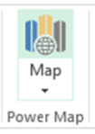






PROCESS MAP (DATAFLOW)
INPUT FILE
REMOTE HDFS SERVER
ORACLE HOSTED
lit_deriv,
lit_nonderiv,
lit_panel,
lit_reportingowners
EXCEL POWER MAP
HDFS DFS CMDS
SSH: SECURE SHELL
BEELINE
LINUX SHELL
SCP: SECURE COPY FROM GIT BASH TO LOCAL FILE SYSTEM
TABLEAU

Slide 6
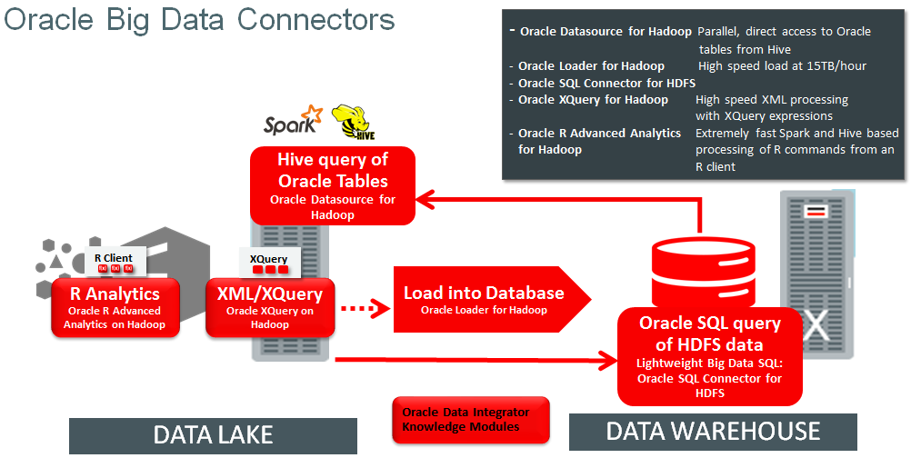

Slide 7
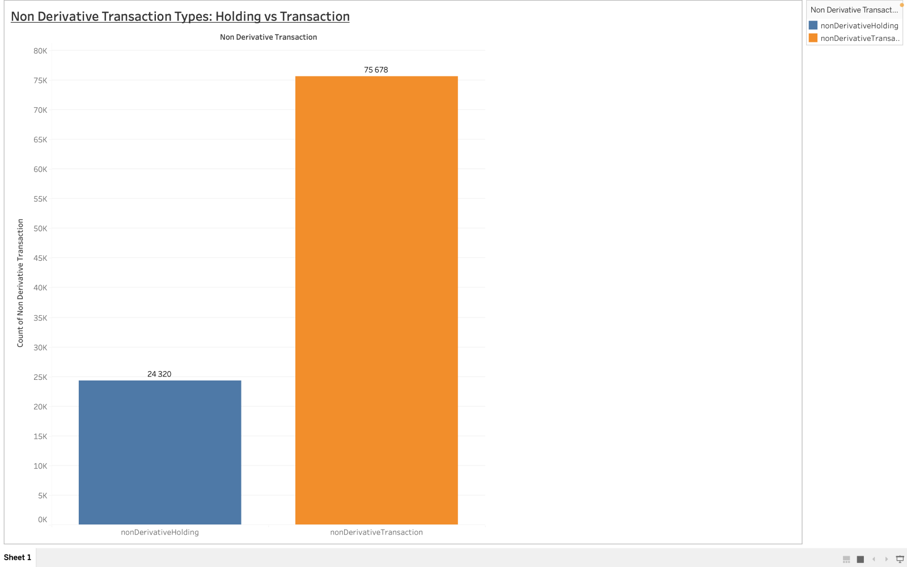
Chart 1

Slide 8
Definition and Explanation Chart 1
100,000: 24% Non-Derivative Holdings types.
75% Non-Derivative Transaction types

Slide 9
Definition Non-Derivative Transaction vs Holding
A non-derivative transaction: simple purchase, sale, or exchange of a security, such as a stock or bond, without the use of derivative products like options or futures. Transaction is straightforward and does not involve any added complexity from derivative instruments.
Non-derivative holding refers to the ownership of a security without the use of any derivative products. The investor has a direct ownership interest in the security itself, without any additional exposure to risks or returns that come from derivative products.

Slide 10
Chart 1 Summary
The difference between non-derivative transactions and non-derivative holdings is that transactions involve buying or selling securities without the use of derivative products, while holdings refer to the direct ownership of securities without any added complexity from derivatives.

Slide 11
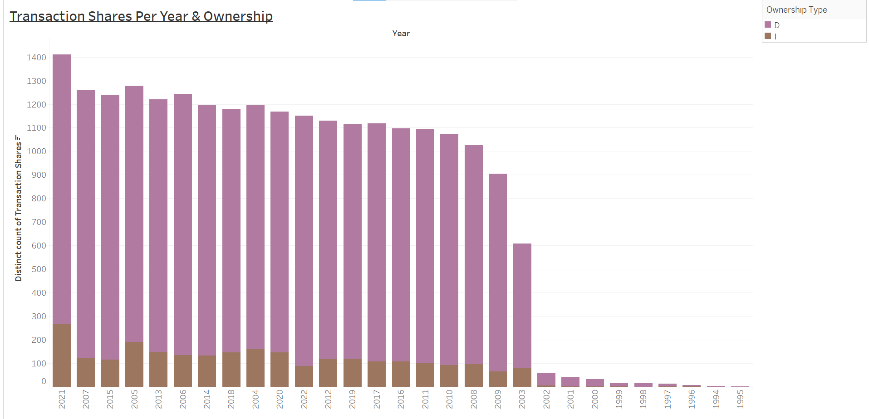

Slide 12
Definition and Explanation Chart 2
Transaction Share: The transaction share refers to the percentage of ownership in a company that is represented by a particular transaction.
Direct ownership refers to a situation where an individual or entity owns an asset or property outright and has legal control and possession over it.
Indirect ownership, on the other hand, refers to a situation where an individual or entity has a claim or interest in an asset or property, but does not have legal control or possession over it. Indirect ownership can take several forms.

Slide 13
Definition and Explanation: Chart 2 Stacked Bar Chart
What IT doomsday event happened during the end of 1999 which may have affected stock prices?
What event happened after 2000 in 2001 which greatly changed the landscape of the USA stock market and corporations trading?

Slide 14
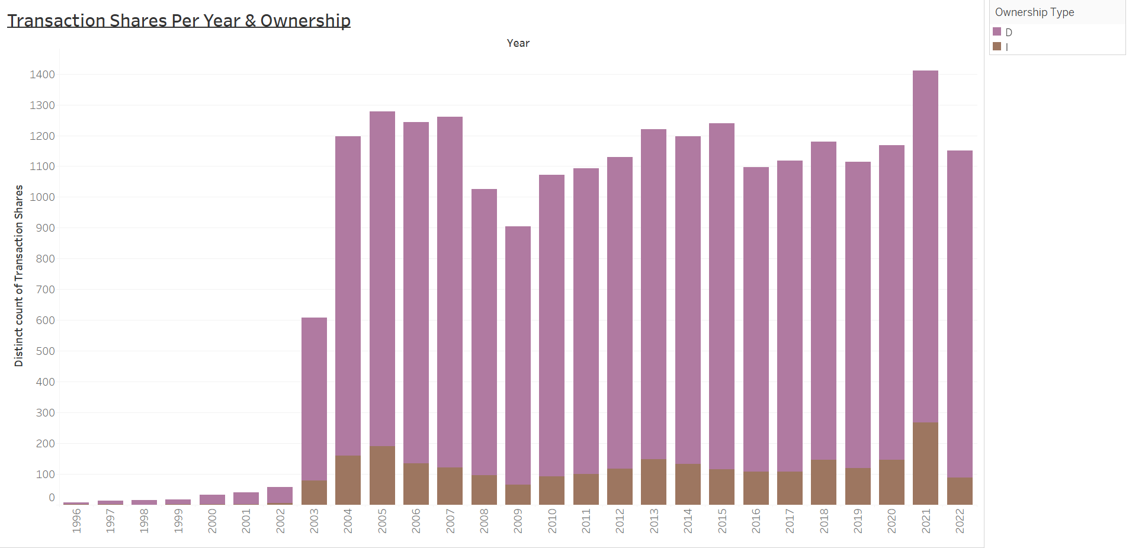
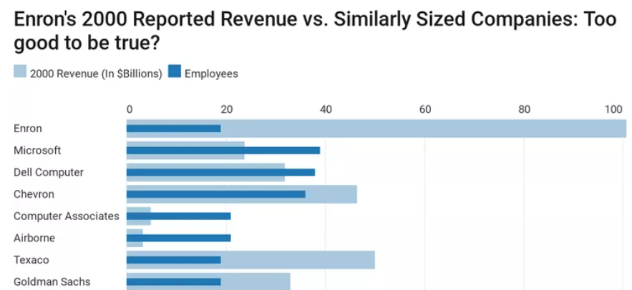
Lessons from Finance History
HOW THE ENRON SCANDAL CHANGED WALLSTREET

Slide 15
Chart 2 Analysis Cont.
2021: Maximum Transaction Shares
1995: Minimum Transaction Shares
We witness a steep increase after the year 2000.
After 2003 the number of transactions shares total drastically increased.
Hive helped us segment the data
How do we eliminate insider trading?
What companies are at risks for such activities?

Slide 16
Chart 3: Geo-Map Background
What does it mean to be a 10-percent trade owner?
What states have the most 10-percent ownership?

Slide 17
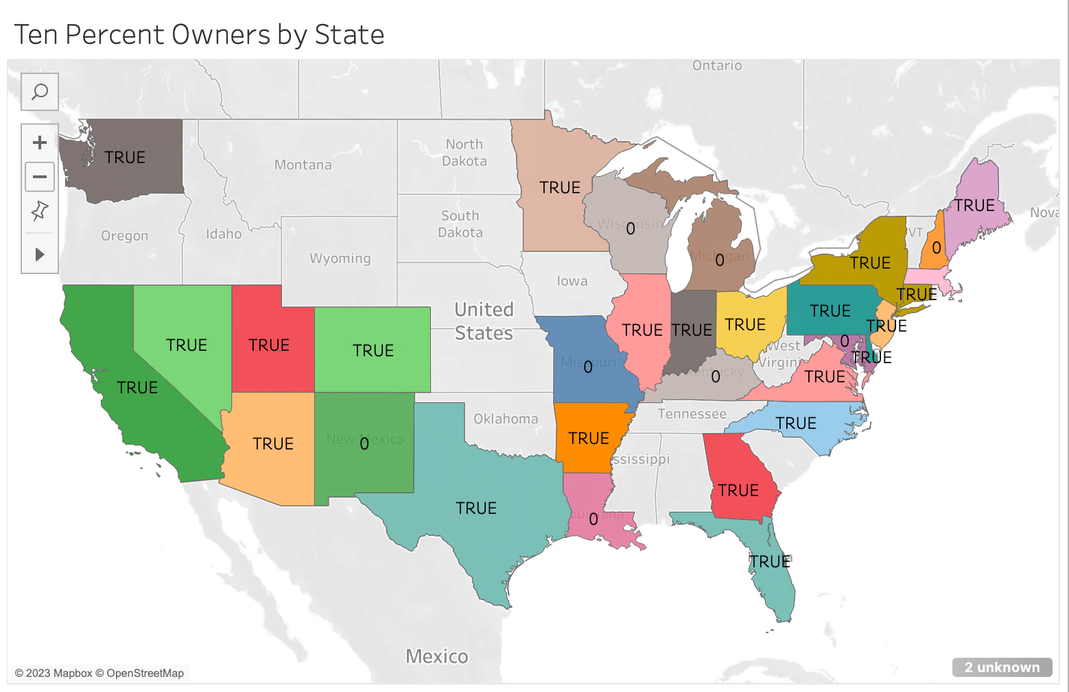

Slide 18

Chart 3: Geo-Map Analysis
What does the chart tell us?
Regulatory Compliance
Taxation and Reporting
Legal Considerations

Slide 19
Chart 4: Filing Date/Security Title
Filing Date: This column indicates the date when the insider trading activity was officially reported or filed with the relevant regulatory authorities. By analyzing the filing dates, you can track the timing and frequency of insider trading activities.
Security Title: This column contains information about the specific security or financial instrument involved in the insider trading transaction. It indicates the name of the security being trade like common stock, preferred stock, options or other financial instruments. It provides insights into the types of securities that insiders are buying or selling.

Slide 20
EXPLANATION OF CHART 4
Examining the dataset and analyzing the relationship between filing dates and security titles, it gains insights into the timing, frequency, and types of securities involved in the insider trading activities. It can help identity patterns, trends or potential correlations between insider trading events and the performance of specific securities.

Slide 21
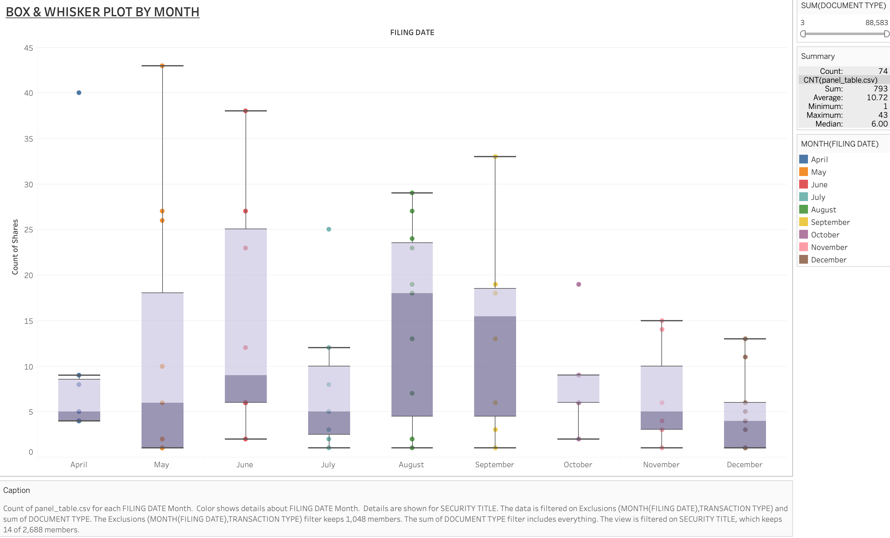

Slide 22
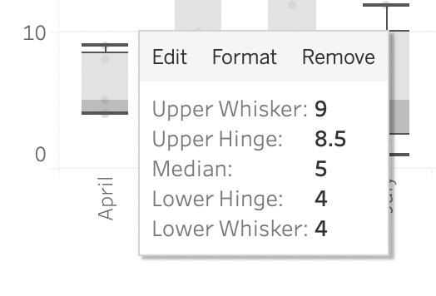
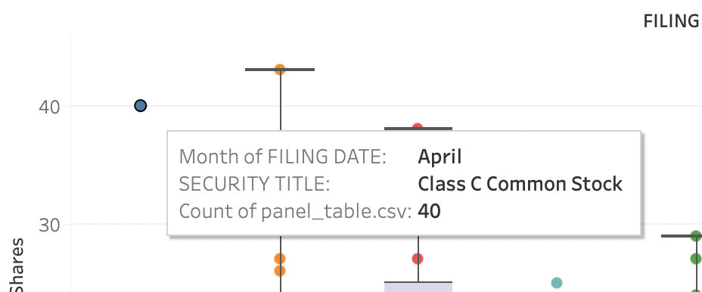
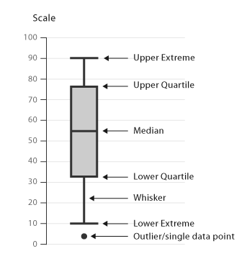
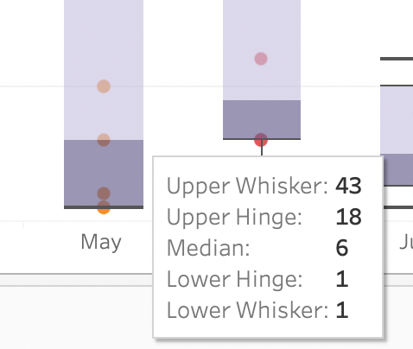
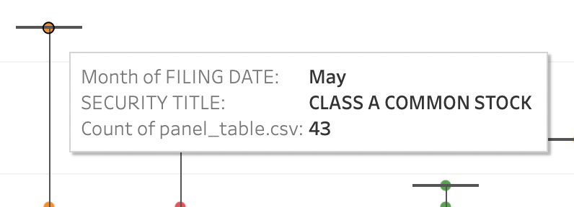

Slide 23


Q & A
Thanks for your time and attention!
https://github.com/jeevanhall/CIS5200HiveTeamProject

Slide 24
References
http://www.ohsdba.cn/index.php?m=Article&a=show&id=351
Balogh, A. Layline Insider Trading Dataset. Harvard Dataverse https://doi.org/10.7910/DVN/VH6GVH (2023).
Balogh, A. Insider trading. Scientific Data 10, 237, https://doi.org/10.1038/s41597-023-02147-6 (2023).

